Slide 1

Canias ERP Basic Screen Functions

Slide 2
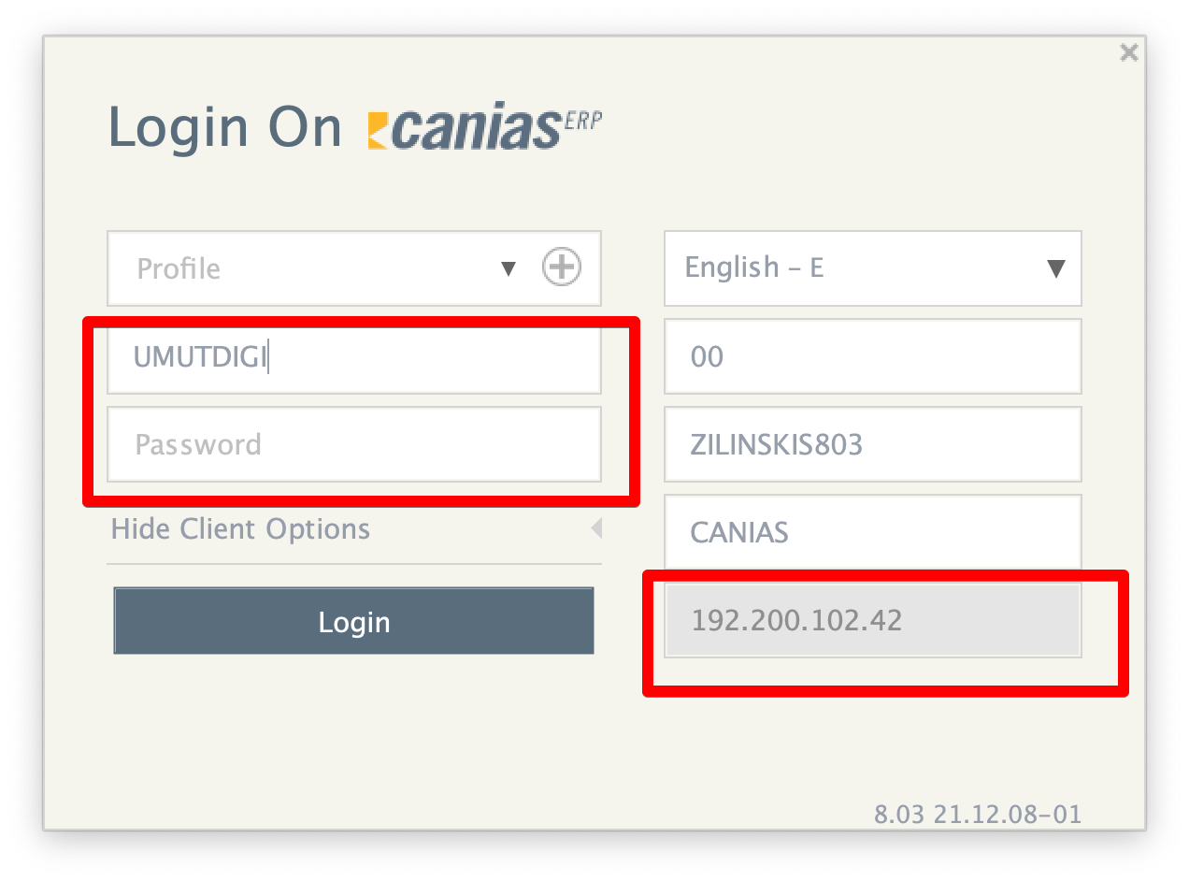
Canias ERP Connection Page http://192.200.102.42/

Slide 3
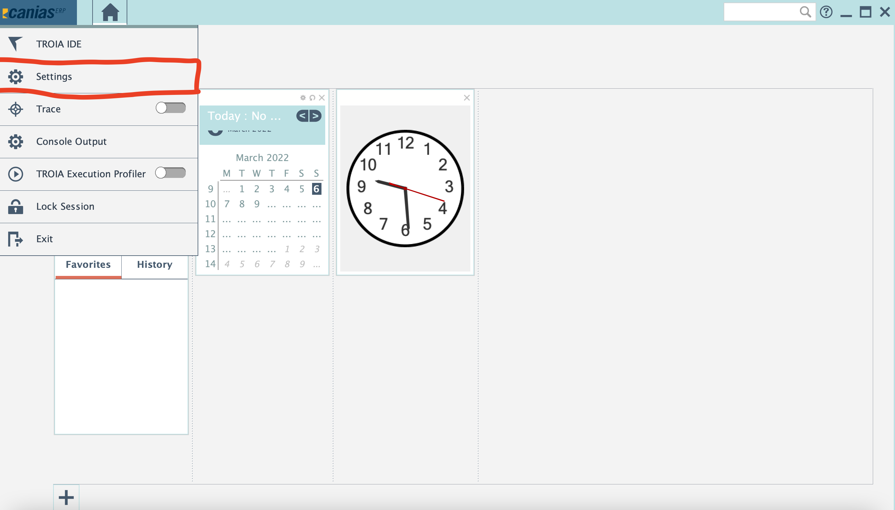
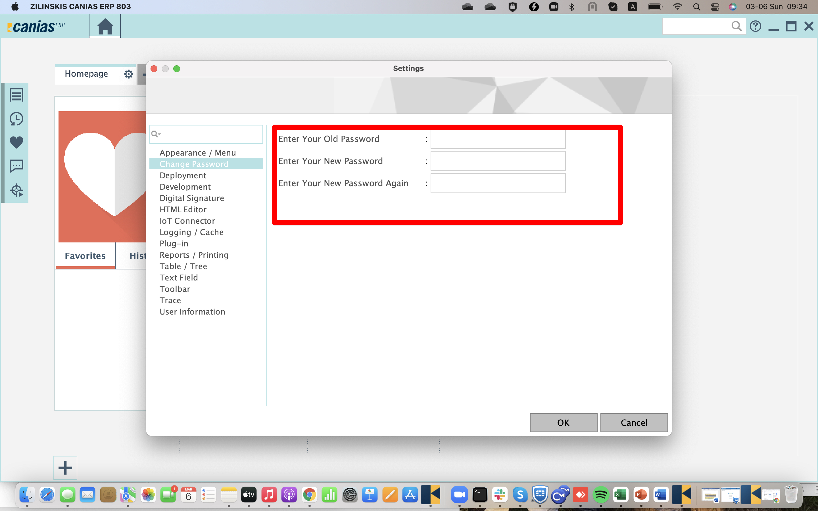
User Password Change Process

Slide 4
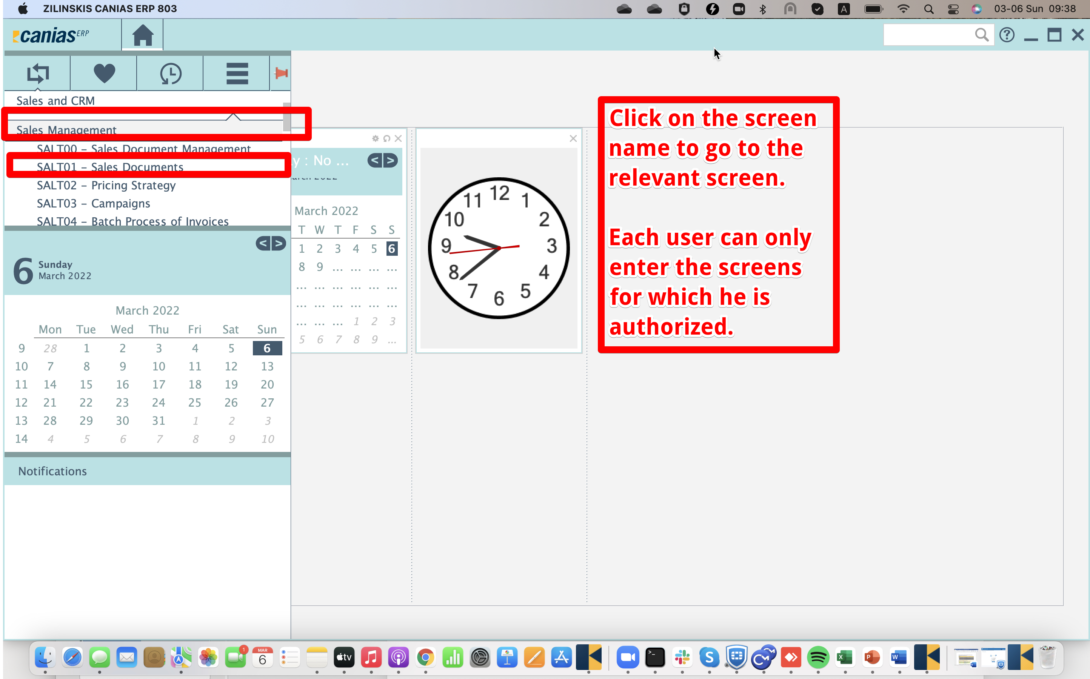
Canias ERP Start Screen

Slide 5
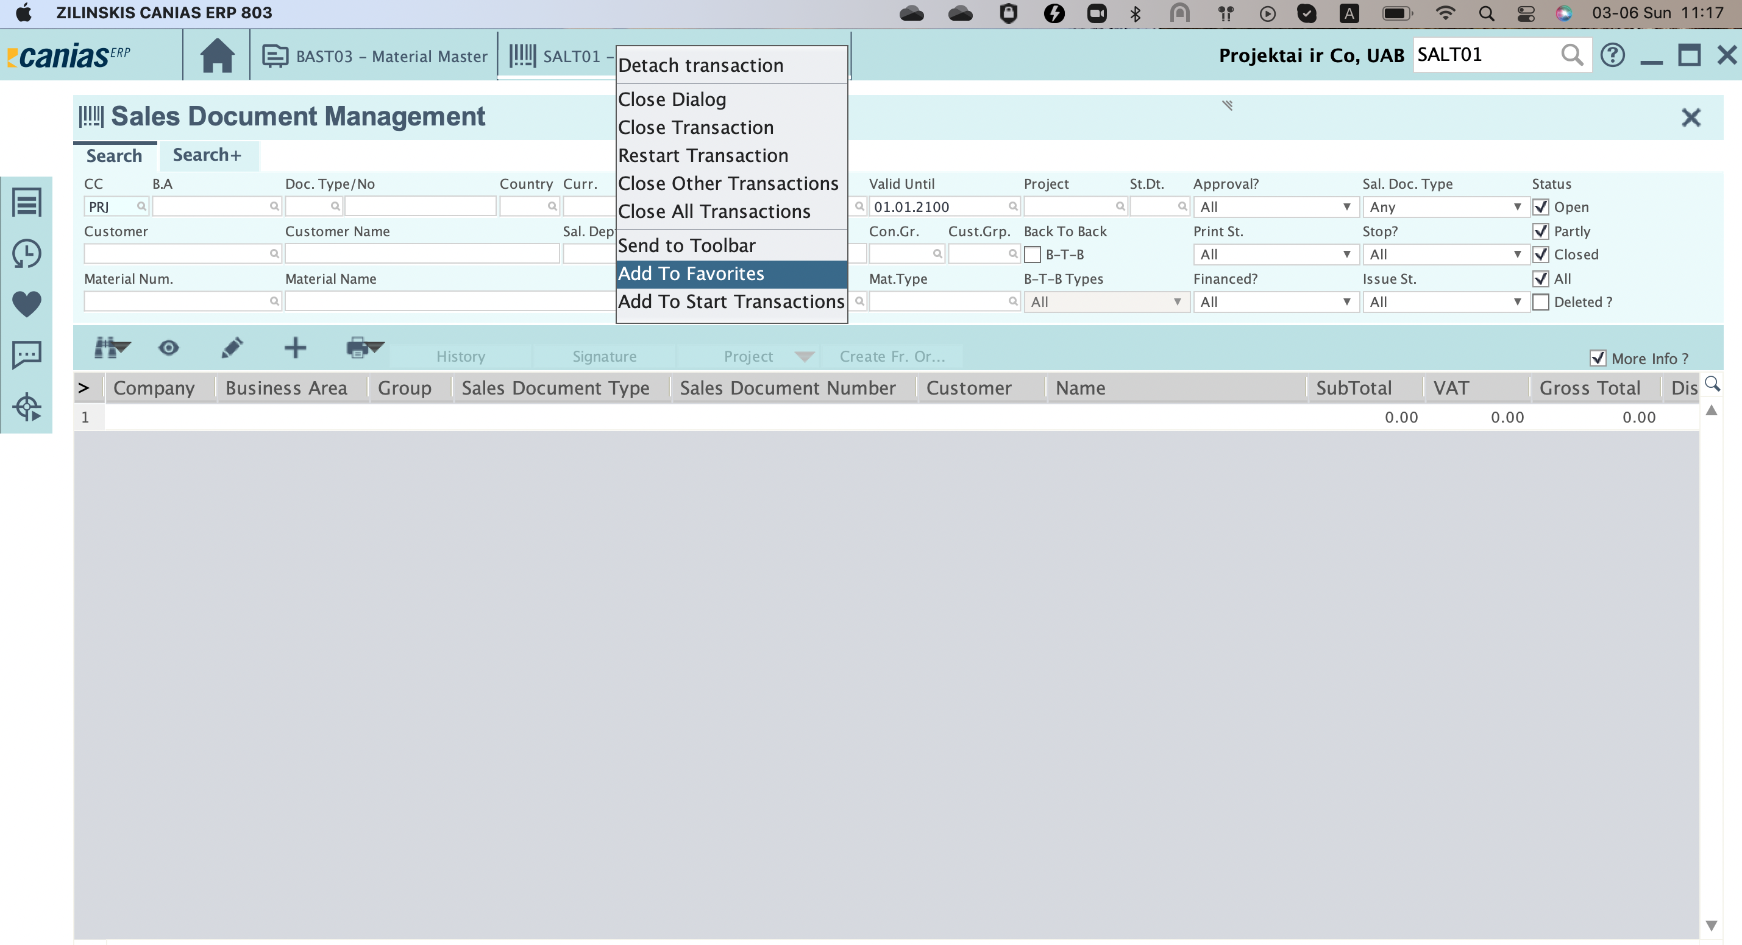
Adding Favorite Favorite Search Criteria
Click right button and add to favorites the transaction which is choosen.

Slide 6
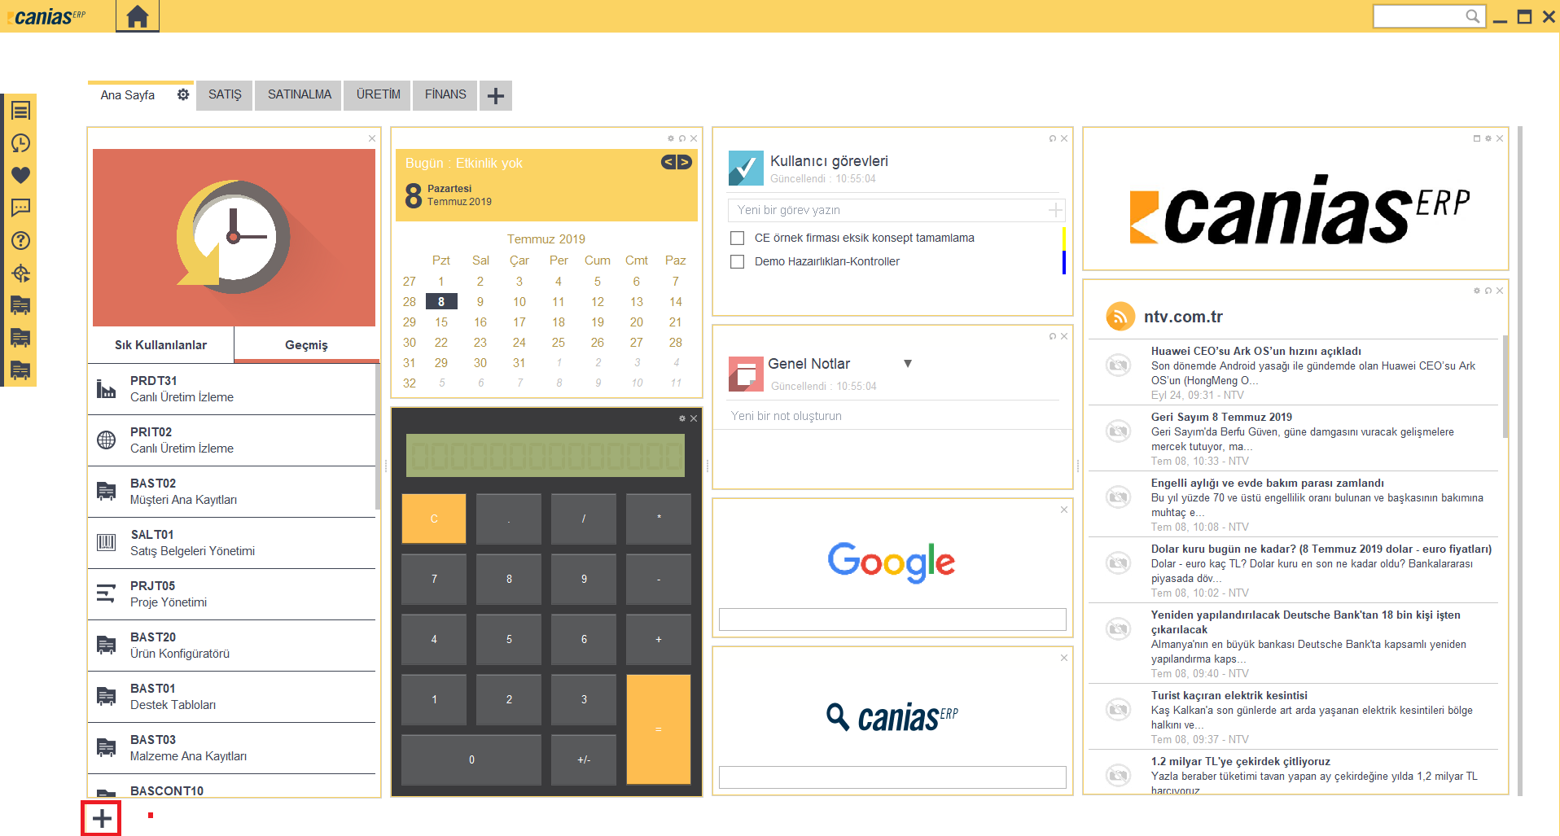
Customizable Screens with Drag & Drop

Slide 7
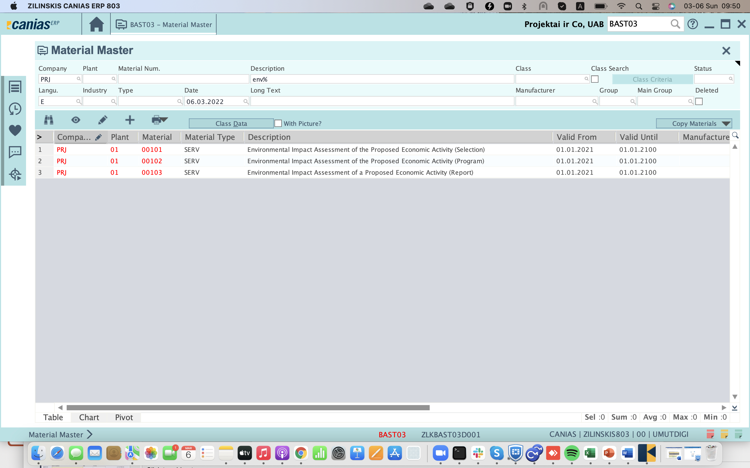
Function Buttons 1 - List
Lists according to the above search criteria
Shortcut → F3

Slide 8
Function Buttons 2 – See Details
Enters the details of the selected record from the list
(Detail information cannot be changed.)
Shortcut → F7

Slide 9
Function Buttons 3 – Making Changes
Enters the details of the selected record from the list
(Detail information can be changed)
Shortcut → F6

Slide 10
Function Buttons 4 – Creating a New Record
Used to Create a New Record
(usually by selecting a reference record from the list)

Slide 11
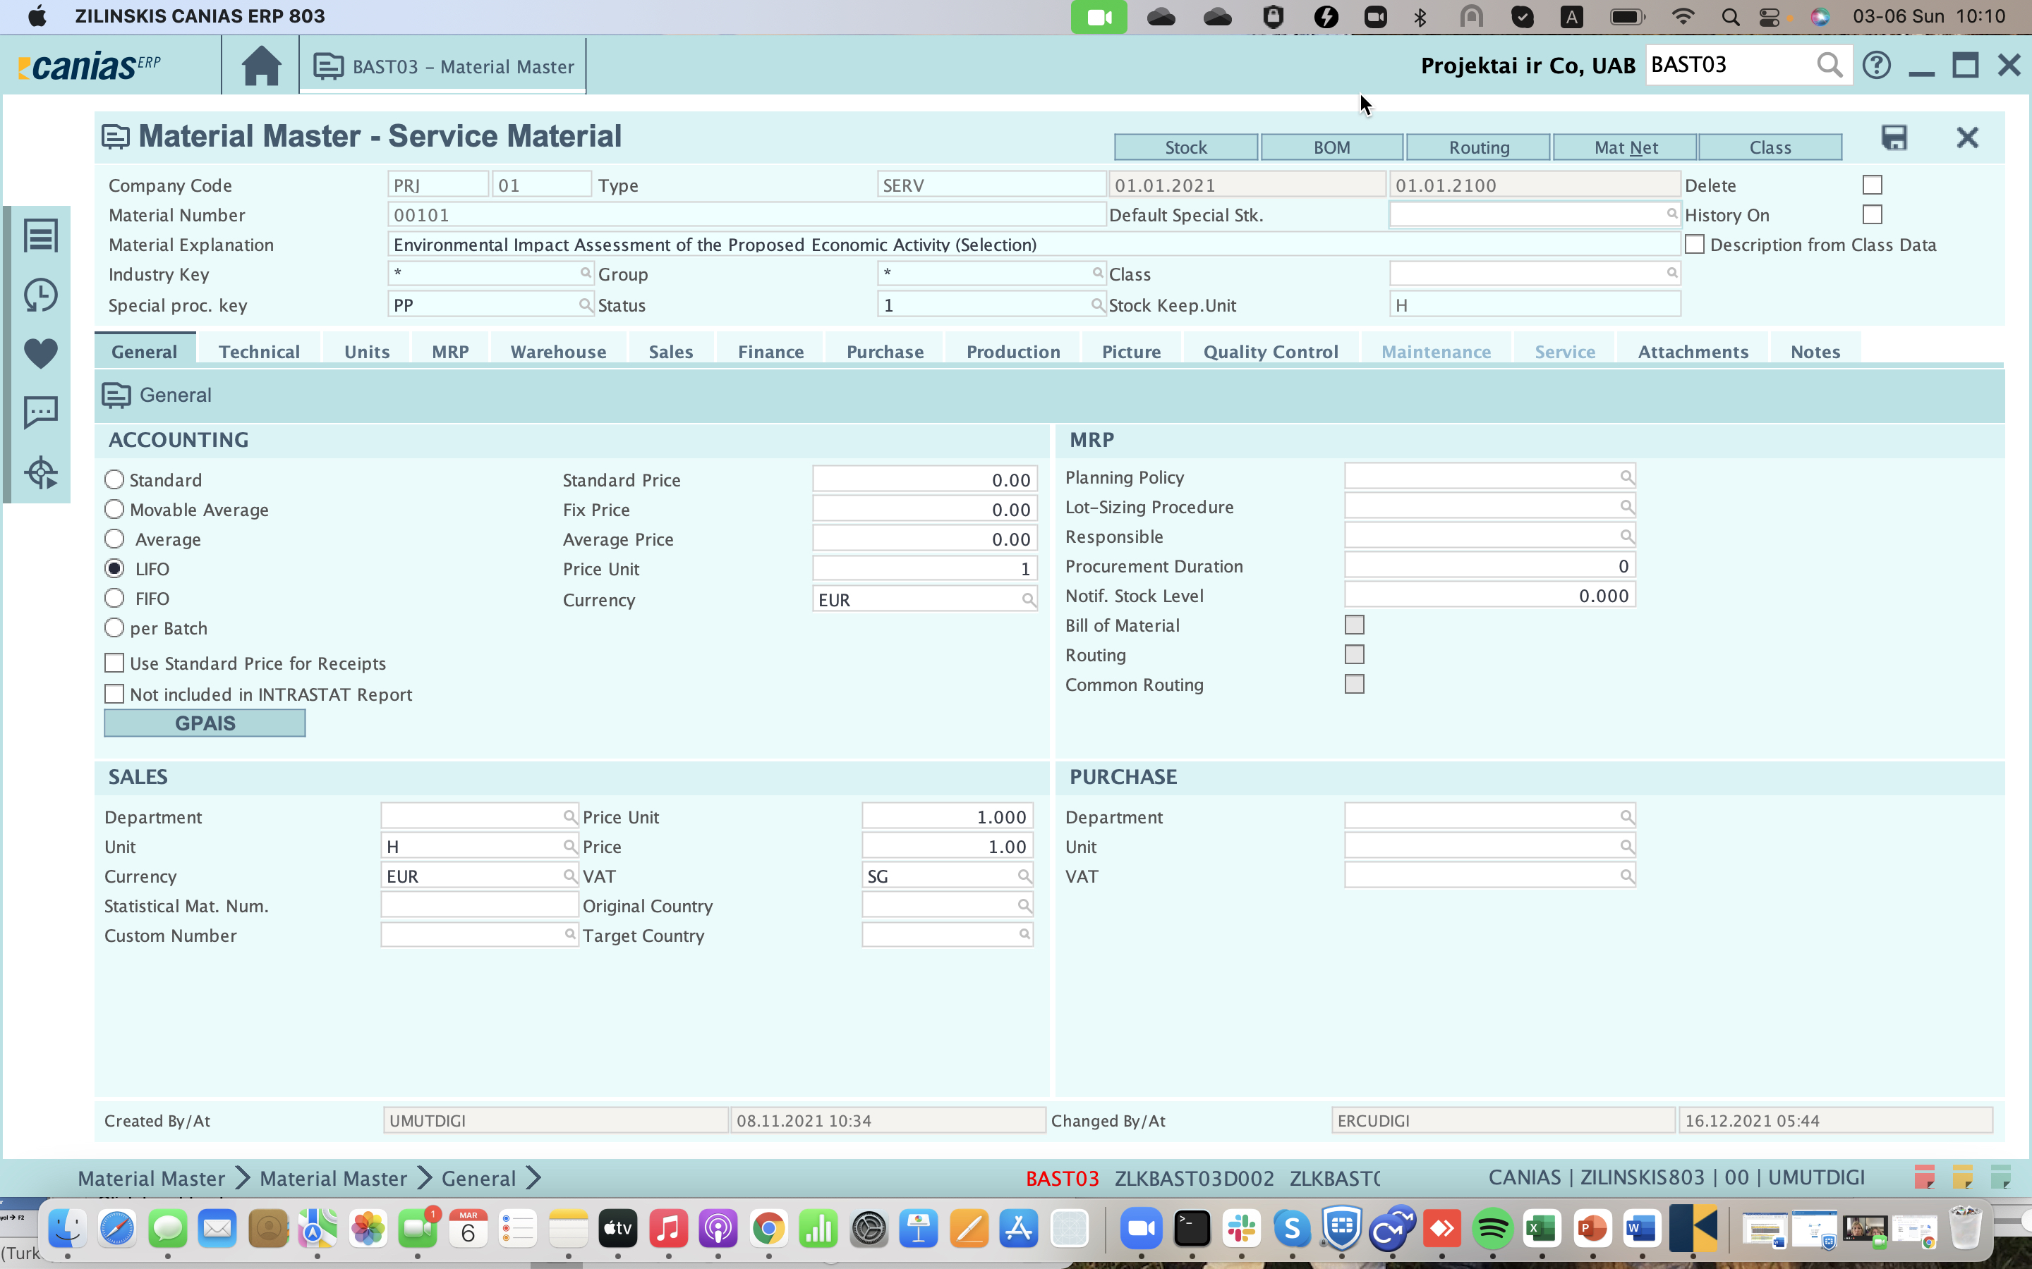
Function Buttons 5 – Saving Information
Records information on the screen
Shortcut → F5

Slide 12
Function Buttons 6 – Turning Off the Screen
Turns off the screen without saving the information on the screen
Shortcut → F2

Slide 13
Function Buttons 7 – PDF Output
Used for output in PDF format
(Output design must be defined in Canias)

Slide 14
Clearing Search Criteria
Shortcut to clear Search Criteria F10

Slide 15
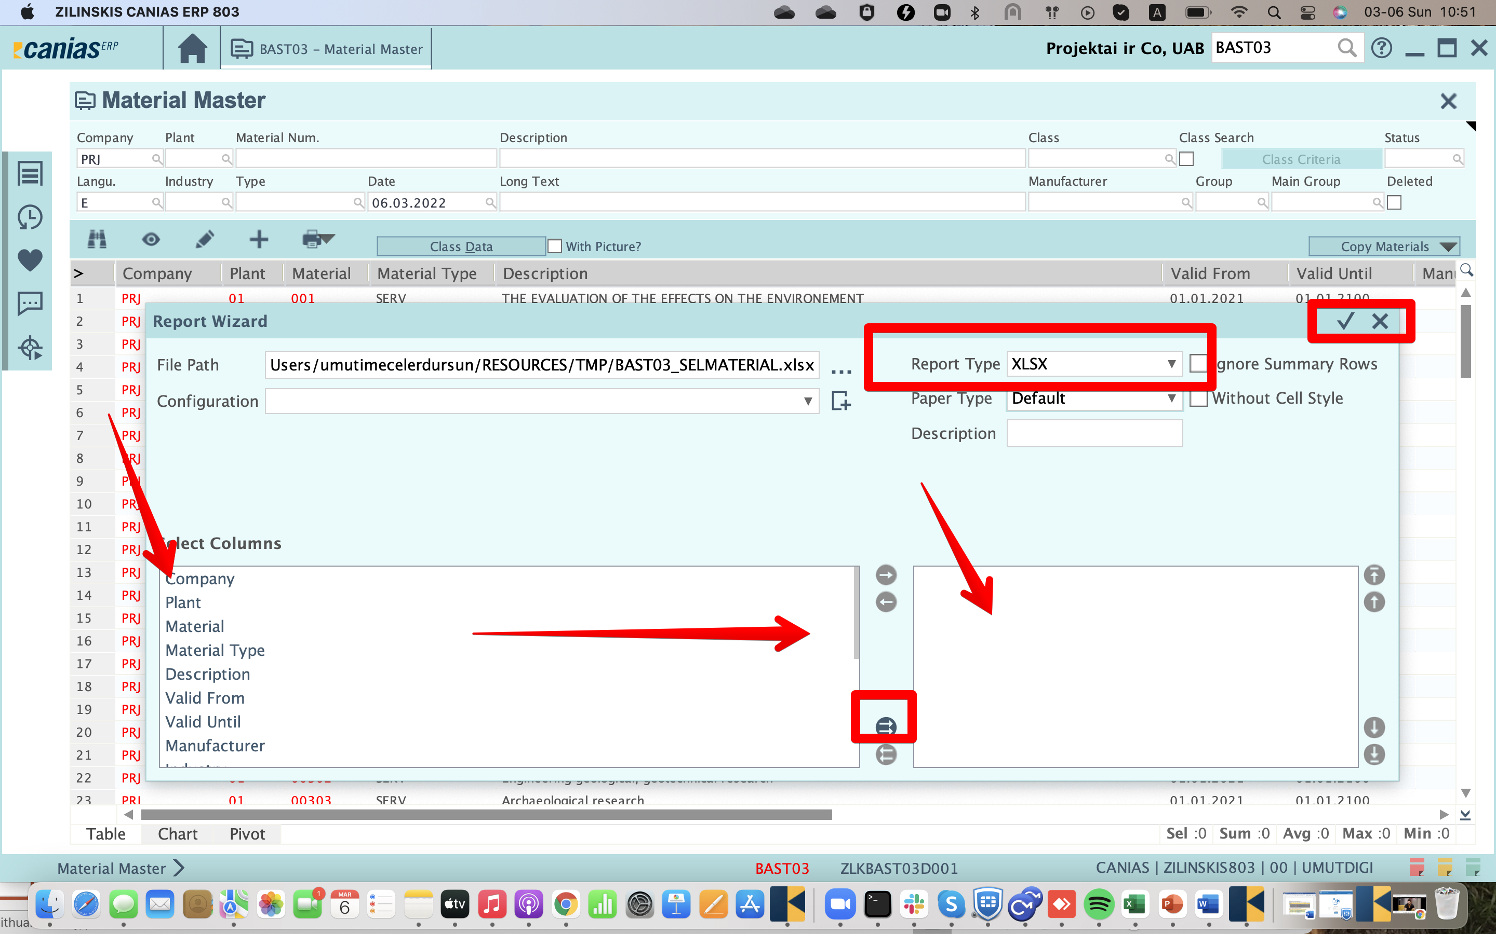
Operations on List 1 – Converting data to Excel format
Right click on the list, select Report Wizard
The left-hand columns are transferred to the right-hand list. For Excel format, XLS is selected and Next button is clicked.

Slide 16
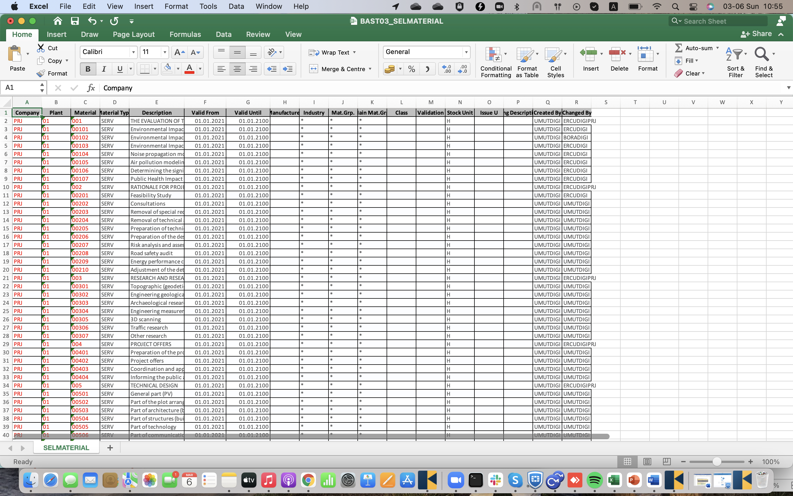
Operations on List 1 – Converting data to Excel format
Getting Canias list results in Excel format with Report Wizard

Slide 17
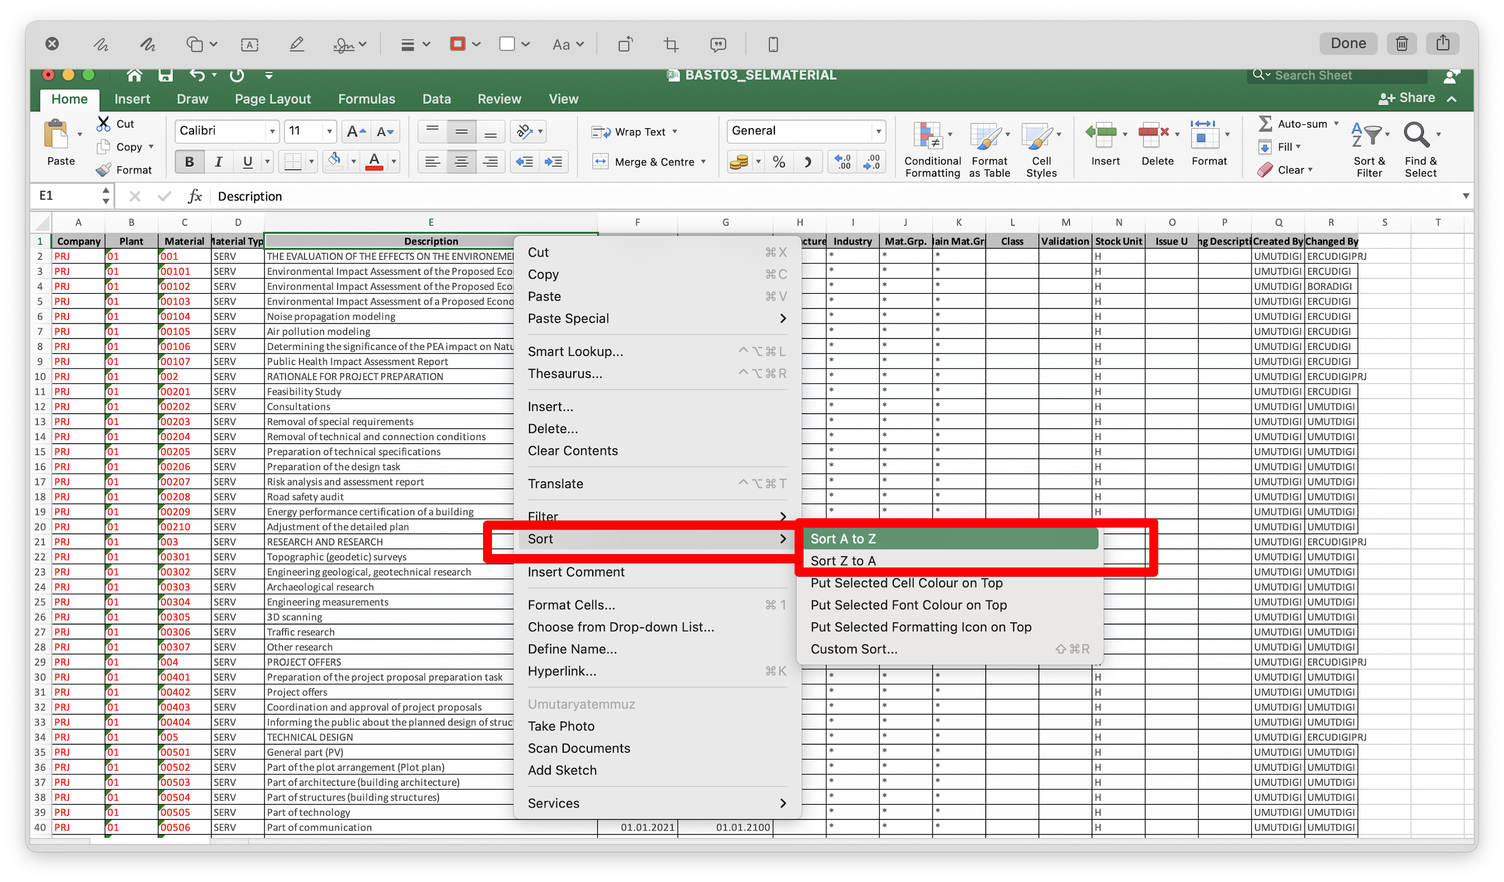
Operations on the List 2 – Sorting Ascending / Descending
Right click on the column
Sort Ascending or Descending on the selected column (Material Description in the example) can be applied

Slide 18
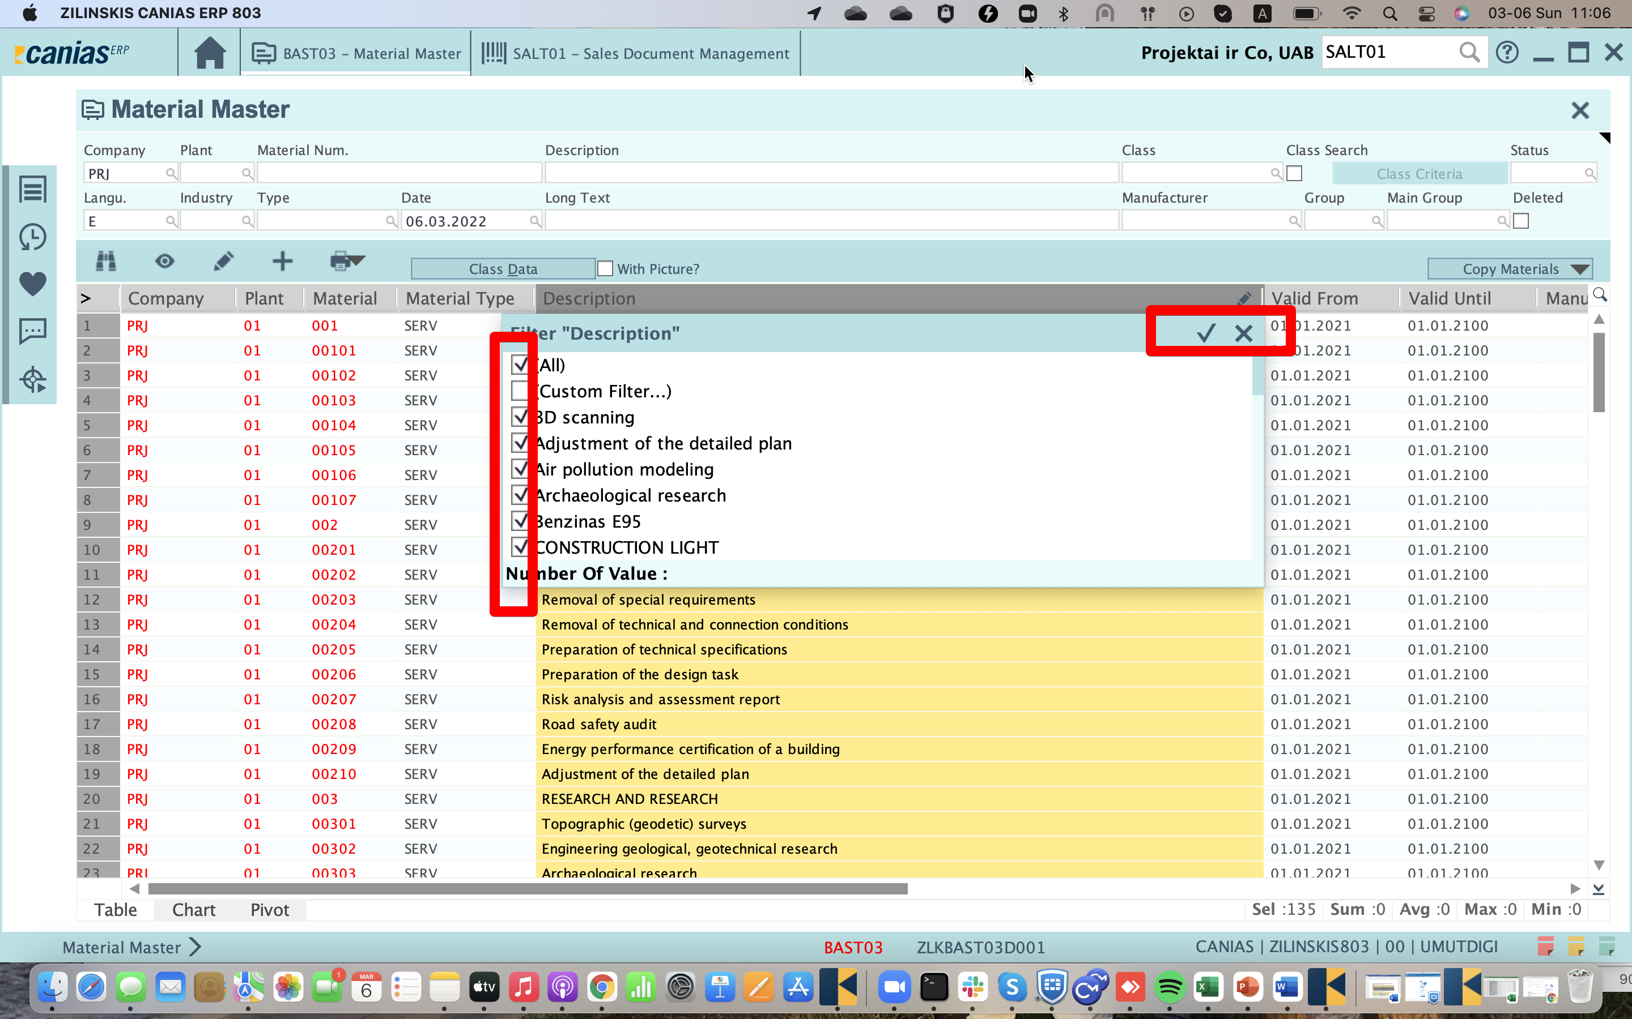
Operations on Lists 4 – Filtering Data
Multiple filters can be applied on the selected column (Material Group in the example)

